Slide 1
What we have learnt in three key-words:
SCAFFOLDING COMMUNICATION STT vs TTT

Slide 2
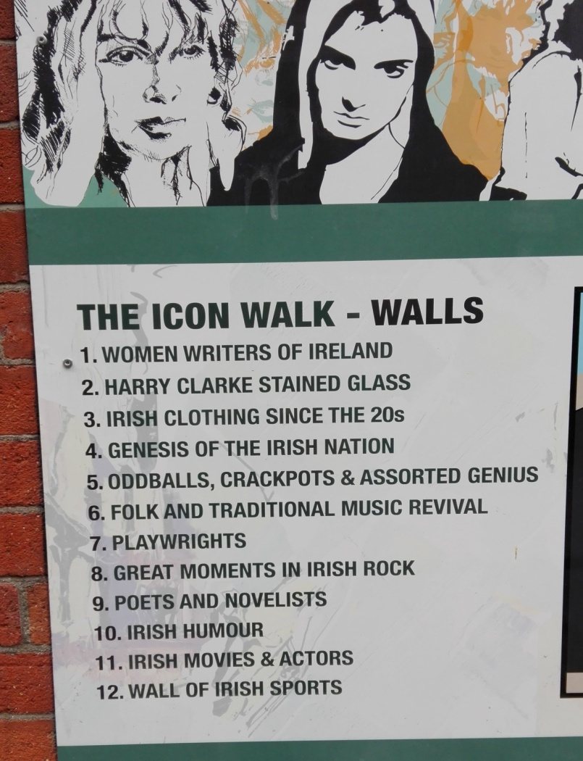
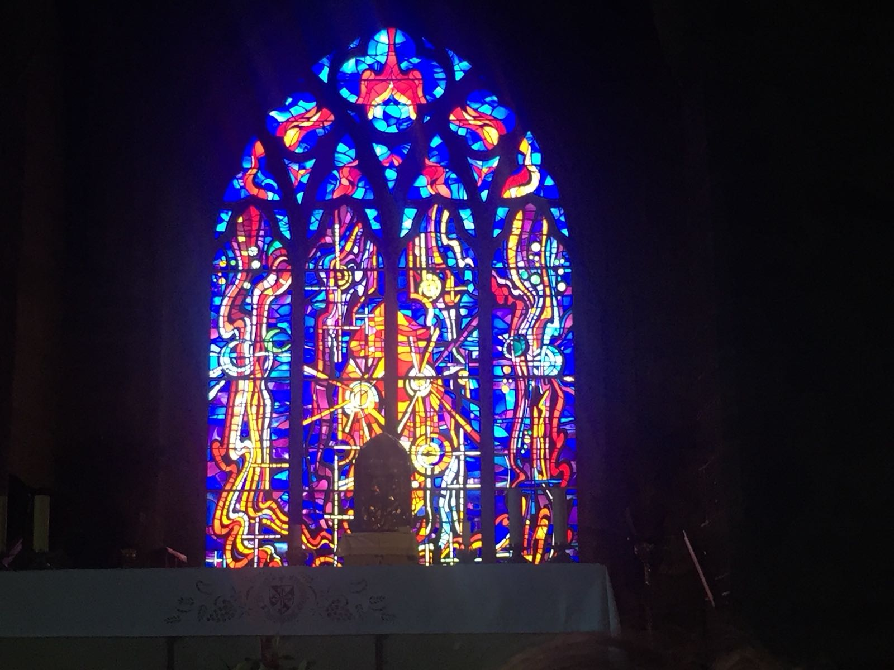
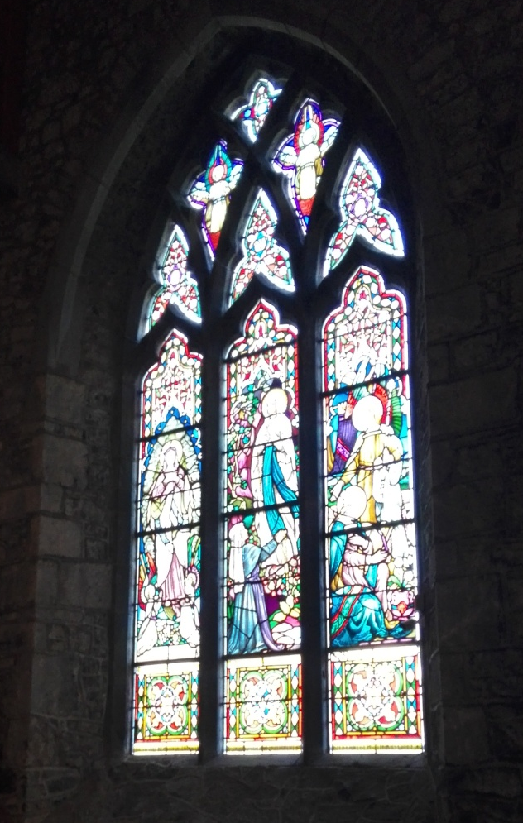
Ireland tells life and history through images

Slide 3
Lesson planning
Introduce the financial crisis of Ireland throughout history with key words and pictures(brainstorrming)
Team work in which each group investigates the causes of poverty and the development of the society(learning by doing)
Students are requested to represent the economic development through three different types of diagrams by giving them some examples (scaffolding)
Students are observed during their learning process (formative assessment).

