Slide 1
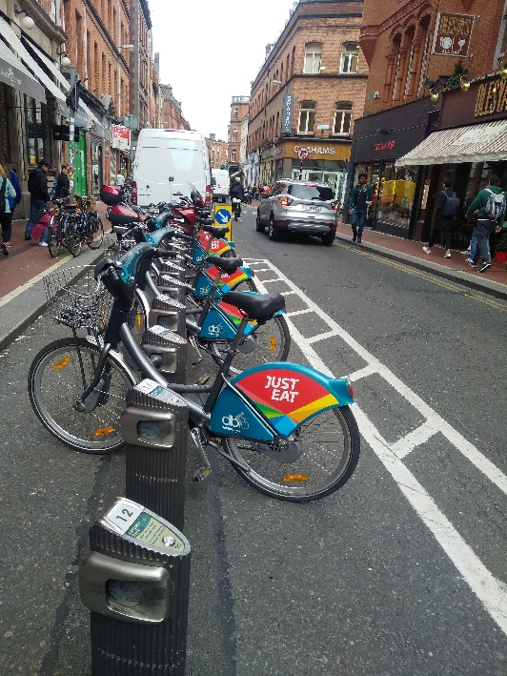
Dublin and bicycles
Field Project: Artistic photos about Dublin
CLIL Course Group 4
Dublin
May 20-26, 2018
Authors
Laura (Italy), Laura (Italy),
Michele(italy), If_kaklamanou(greece)

Slide 2
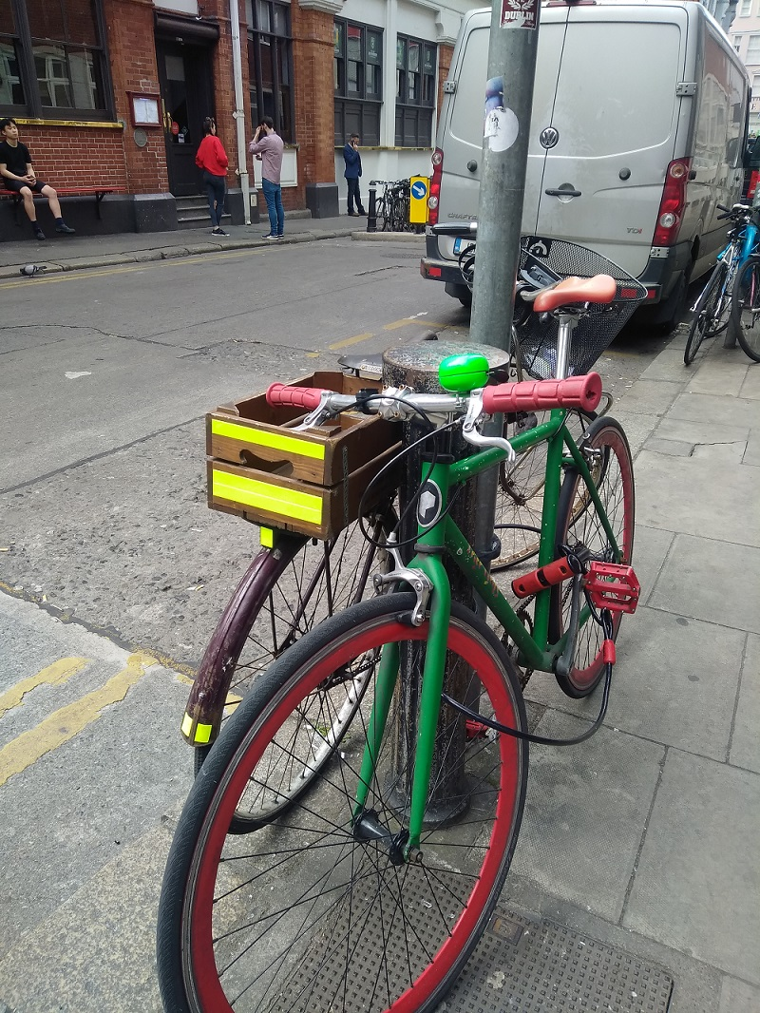
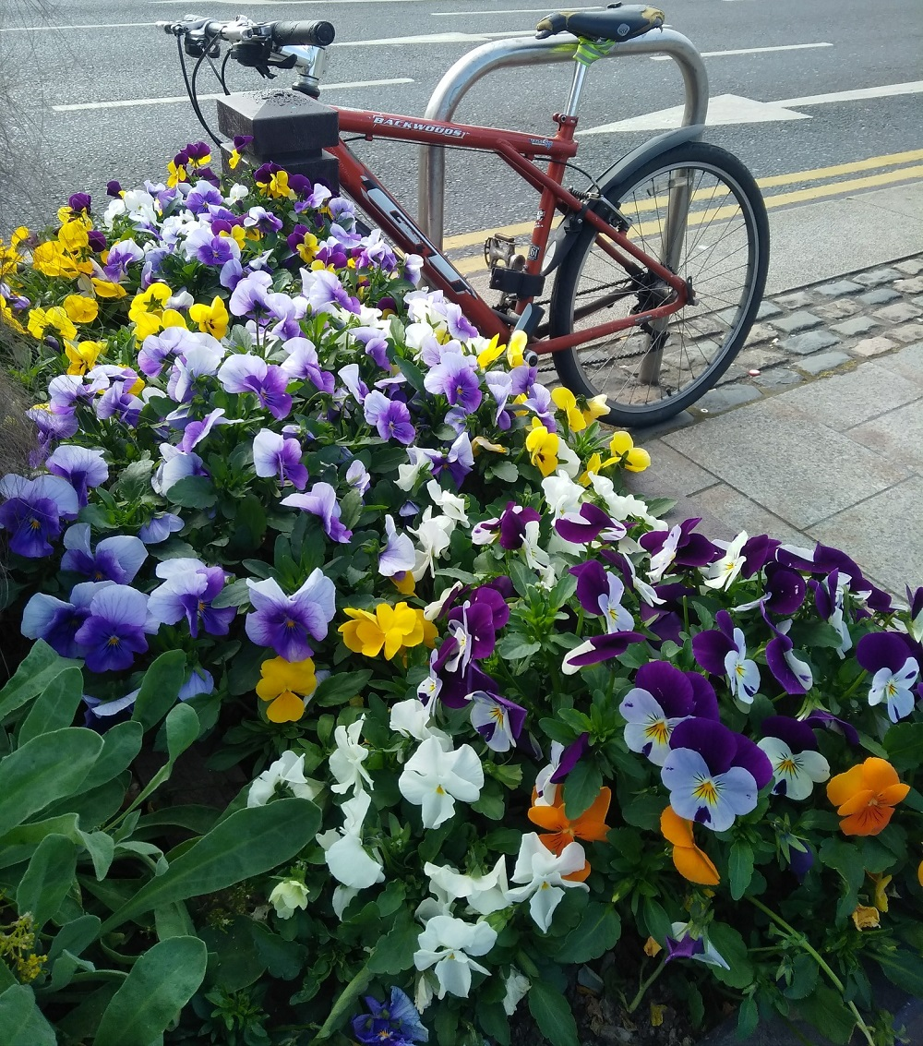
Colors

Slide 3
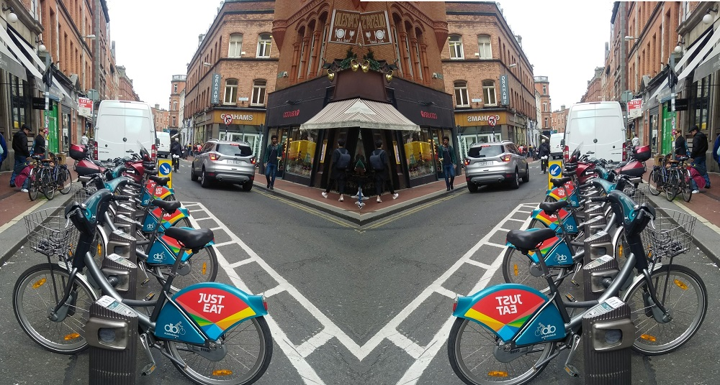
experimental

Slide 4
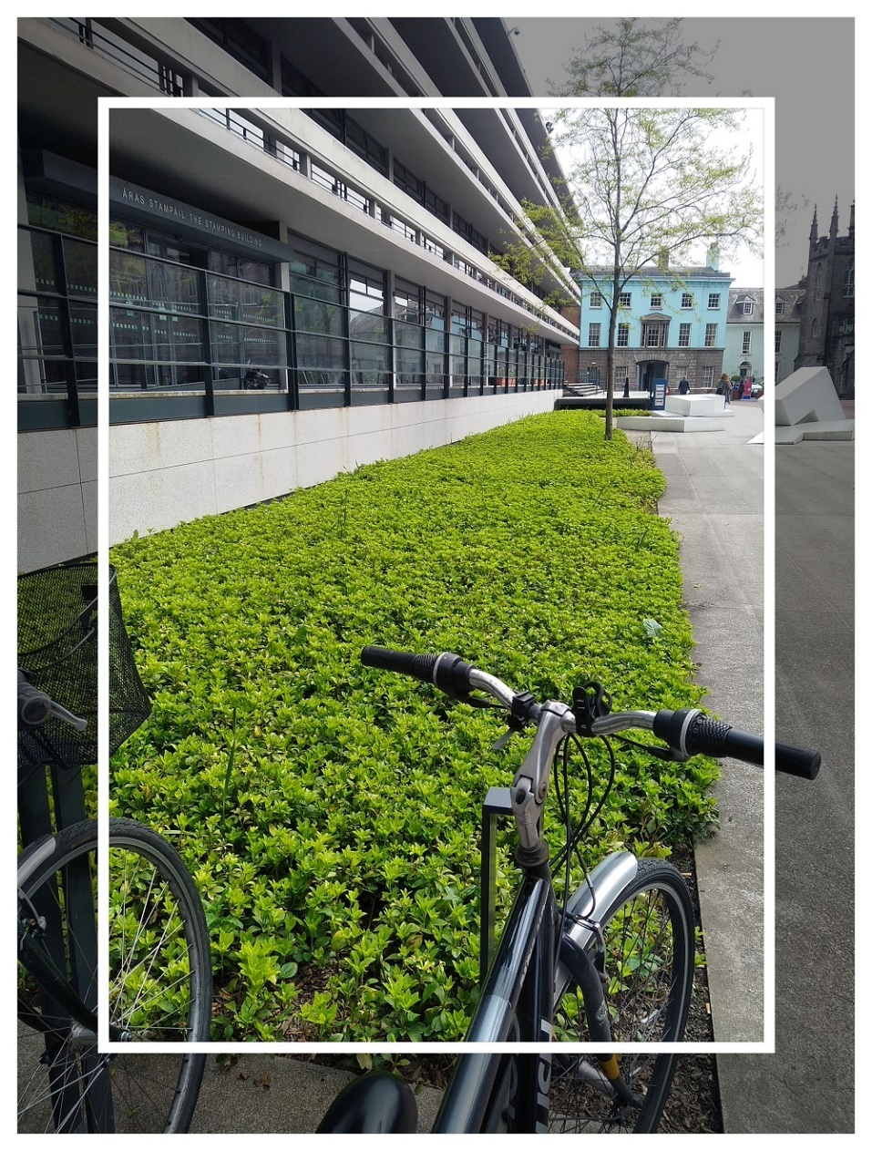
frames

Slide 5
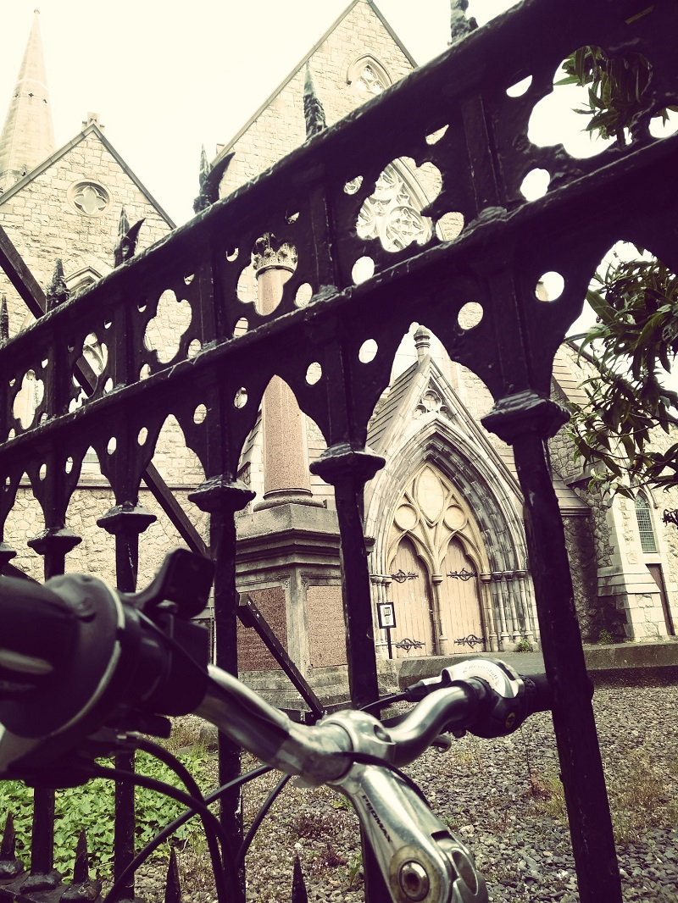
reflection

Slide 6
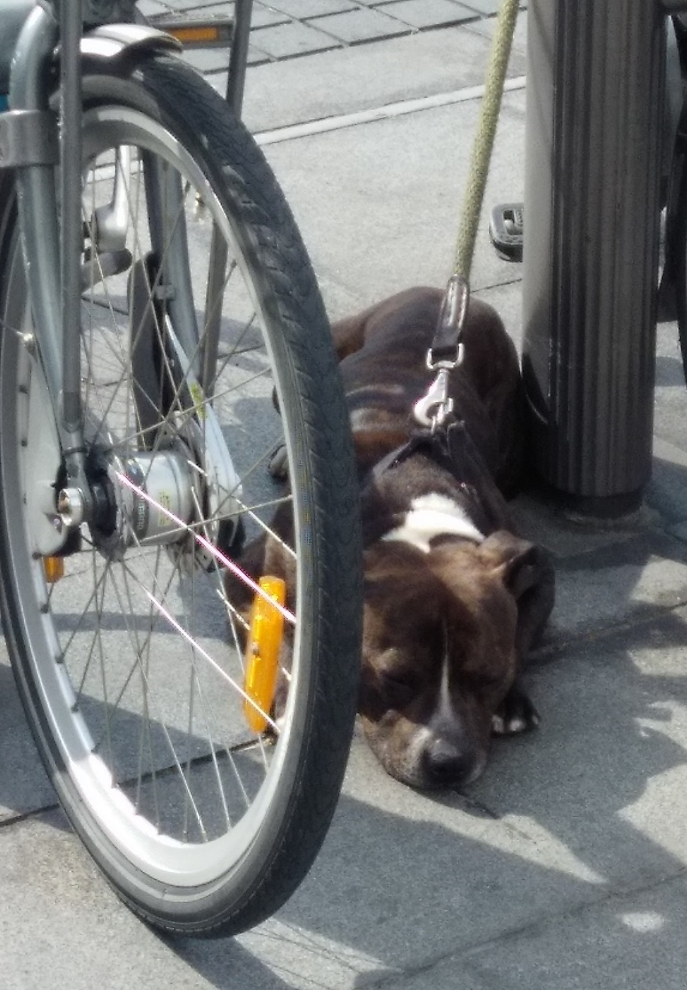
spy

