Slide 1
TCA Study Visit The future begins today: educational and professional guidance practices Botoșani, 10-14 October 2016
Amelia Ciadamidaro

Slide 2
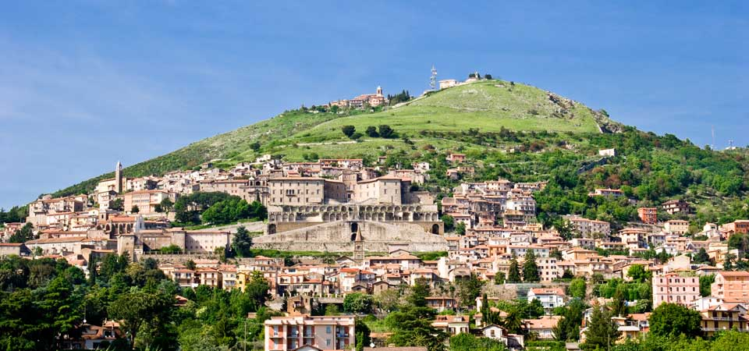
Something about Palestrina
https://prezi.com/cy3ua3fr8ncv/welcome-to-palestrina/?utm_campaign=share&utm_medium=copy

Slide 3
The campus

Slide 4
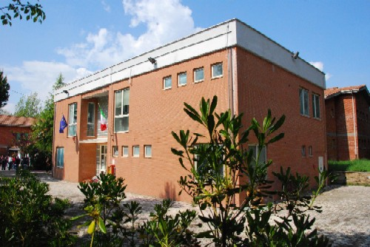
The school
The Eliano-Luzzatti I.I.S. is a big school composed of a Uman Science and Classical Lyceé that recently merged a Technical Institute (Administration and Finance/ construction and urban development)
http://www.iiselianoluzzatti.gov.it/

Slide 5
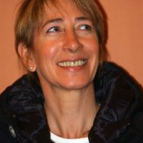
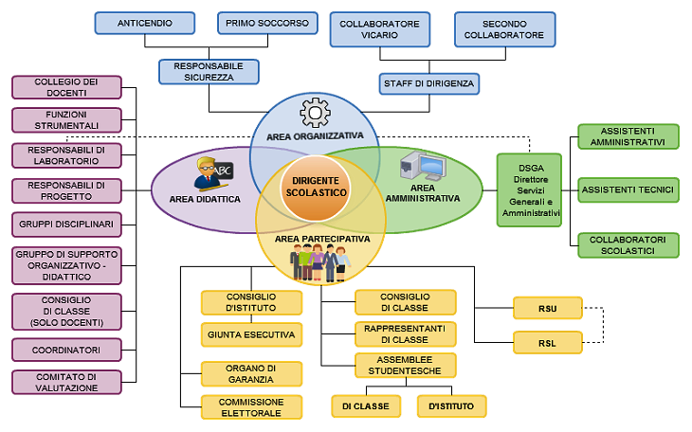
Organization chart
Mrs Cinzia Delisi
School Headmistress
… summing up…
DSGA Mrs Giuseppina De Martino
113 teachers
13 school caretakers
5 technical assistants
10 administrative assistants

Slide 6
School population
Number of students:
1238
Human Science and Classical Lyceé
849
Technical Institute
389
Number of remedials
73
134
715
285
104
Human Science and Classical Lyceé
49
Technical Institute
24
The age range of the students is 14-19
20
4
13
36

Slide 7
International Activities
Our school is active in the field of:
European projects
Liceum Ogolnoksztalcace im. Noblistow Polskich
Rydułtowy – Poland
Spojena skola
Bratislava – Slovakia
Chastna profilirana gimnazia s chuzhdoezikovo obuchenie "Chelopech"BG412 – Bulgaria
Basogretmen Ataturk Anadolu Lisesi
Merkez – Turkey

Slide 8
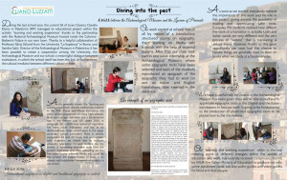
International Activities
A project implemented within the activity work-related learning and thanks to the partnership with the National Archaeological Museum of Palestrina
EAGLE
The activities have dealt with the translation of inscriptions from Latin into English and Italian
Finally the translated epigraphs have been uploaded on the free-open source software Media-Wiki

Slide 9
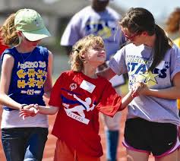
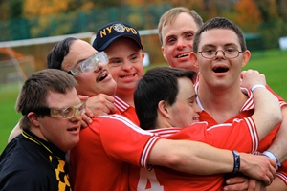
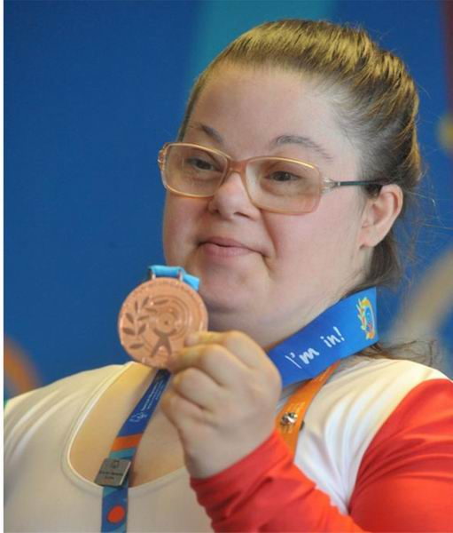
International Activities
Special Olympics is a global movement of people creating a new world of inclusion and community, where every single person is accepted and welcomed, regardless of ability or disability.
SPECIAL OLYMPICS
Through sports, athletes are seeing themselves for their abilities, not disabilities. Their world is opened with acceptance and understanding. They become confident and empowered by their accomplishments. They are also making new friends, as part of the most inclusive community on the planet.
Athletes are children and adults with intellectual disabilities from all around the world. They are finding success, joy and friendship as part of the global community. They're also having lots of fun!

Slide 10
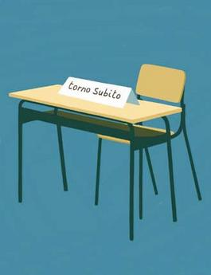
but…
what about early school leaving?

Slide 11
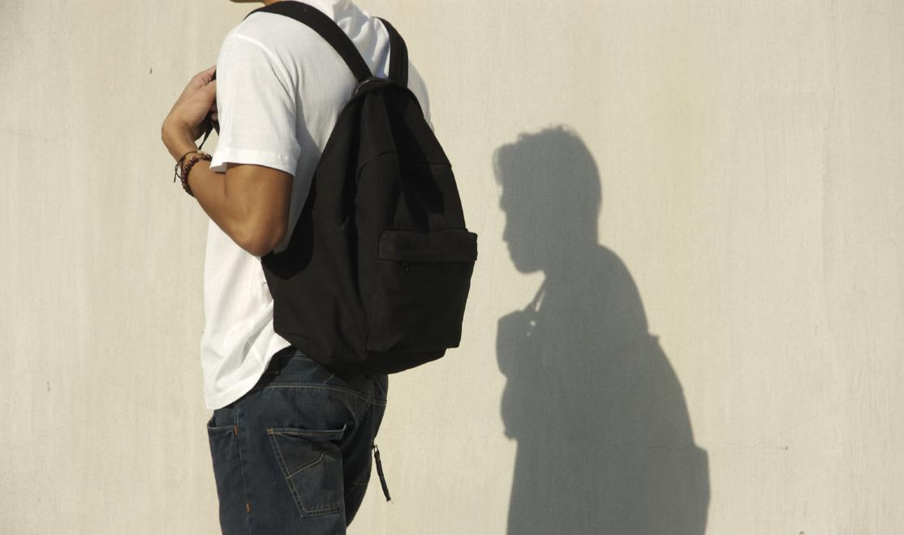
A bit of history…
School year 2012/13
“IN PRIMIS… GLI ULTIMI ”
To support learning for every child in order to tackle early school leaving
I phase: research-action
IV phase: outcomes and feedbacks
3 risk factors:
III phase: remedial activities*
II phase: material processing
scholastic
Pay attention to students with learning disabilities!
behavioural
socio-cultural
* All the classes of first biennium were involved
testing

Slide 12
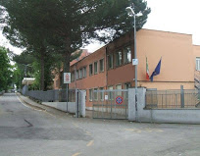
School partners

Slide 13
Project data
Number of students 1575 | Number of students involved in the project 142
Number of school teacher 150 | Number of school teacher involved in the project 16
Number of school classes 64 | Number of school classes involved in the project 6
Number of school caretakers 28 | Number of school caretakers involved in the project 10

Slide 14
Teaching strategies
Task based learning activities
Peer tutoring
Cooperative learning

Slide 15
Outcomes
School drop-out rate/ incoming 35,3 % | School drop-out rate/ outgoing 28%
School failure rate/incoming 7,75% | School failure rate/ outgoing 9,78%

Slide 16
Outcomes
Promoting the educational success / tackling any form of disadvantage through the empowerment of:

Slide 17
Outcomes
Substantial reduction of school drop-out rate with particular reference to:

Slide 18
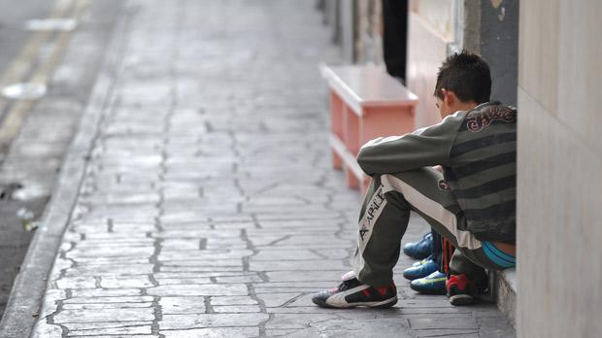
… and then
School year 2016/17
“APPrendi-menti: in primis gli ultimi 2.0”
as the previous project, it will be adopted to tackle early school leaving

Slide 19
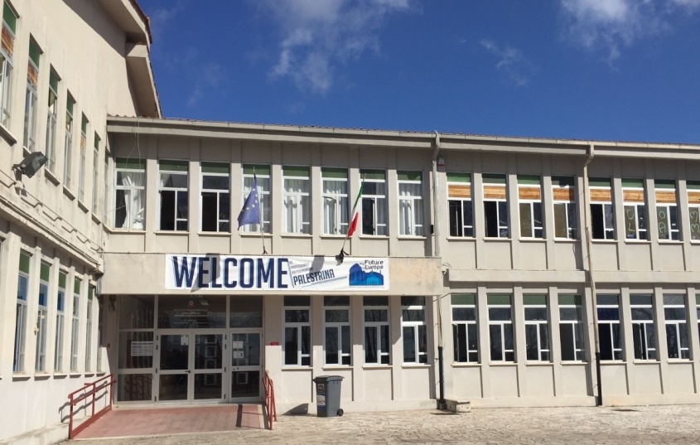
School partners

Slide 20
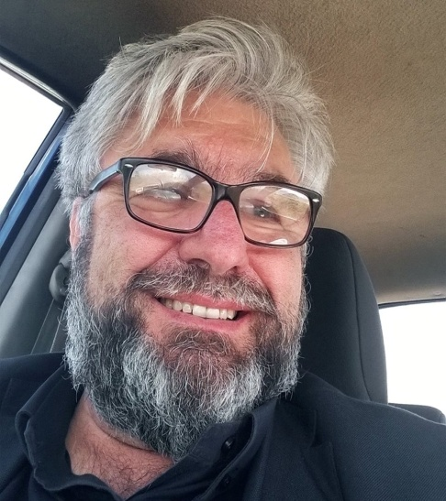
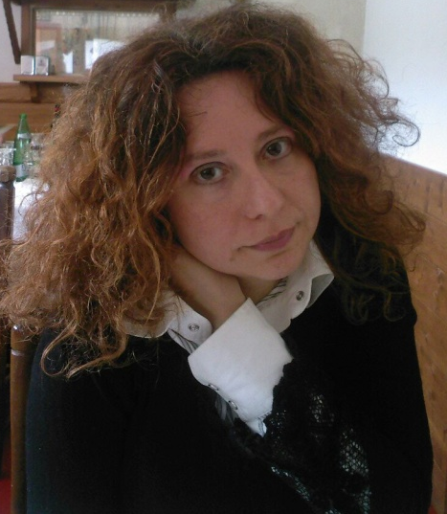
Project referents
Mrs Antonella Parisi
IIS Borsellino Falcone
Zagarolo
Mr Alberto Iacovacci
IIS Eliano-Luzzatti
Palestrina
Mrs Amelia Ciadamidaro
IIS Eliano-Luzzatti
Palestrina
Mr Enzo D’Urbano
IIS Professionale
Palestrina

Slide 21
What’s the news?
Task based learning activities
Peer tutoring
Cooperative learning

Slide 22
So…
Our purpose is now to explore new interactive learning enviroments thanks to social media and web 2.0 to improve our students digital competences
All the students of first classes and most of all low ability learners at risk of failure will be accompanied by a mentor/tutor
Working on task based learning activities and using Edutainment instruments to apply knowledge in real world situations, we are convinced to scaffold and build our students skills

Slide 23
Goals
Through online courses on basic subjects and Study Method, specifically thought in a playful approach, we intent to engage our students and obtain impressive and effective results in terms of:
containing the % of school dropouts realizing prevention and contrast to the lack of motivation for learning
supporting and spreading the culture of inclusion based on the needs of each student
encouraging forms of online cooperative learning
enhancing plurality of teaching styles to improve learning by finalizing them
promoting EDUCATIONAL SUCCESS of all students
increasing the level of self-confidence of each student

Slide 24
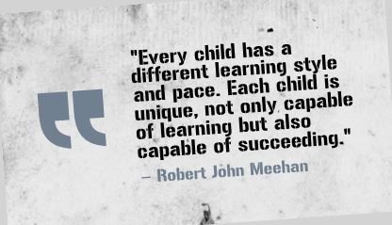
In conclusion

Slide 25
Amelia Ciadamidaro
a_ciadamidaro@virgilio.it
Telephone number +393385468066

